Slide 1
Paper review- SpeechT5: Unified-Modal Encoder-Decoder Pre-Training for Spoken Language Processing
Junyi Ao^{1,2,* ,}Rui Wang^{3,*} ,Long Zhou^{4,*} Chengyi Wang⁴, Shuo Ren⁴, Yu Wu⁴, Shujie Liu⁴, Tom Ko¹, Qing Li², Yu Zhang^{1,5}, ZhihuaWei³, Yao Qian⁴, Jinyu Li⁴, Furu Wei⁴
¹Department of Computer Science and Engineering, Southern University of Science and Technology
²Department of Computing, The Hong Kong Polytechnic University
³Department of Computer Science and Technology, Tongji University
⁴Microsoft
⁵Peng Cheng Laboratory
Ao, J., Wang, R., Zhou, L., Liu, S., Ren, S., Wu, Y., Ko, T., Li, Q., Zhang, Y., Wei, Z., Qian, Y., Li, J., & Wei, F. (2021). SpeechT5: Unified-Modal Encoder-Decoder Pre-training for Spoken Language Processing. ArXiv, abs/2110.07205.

Slide 2
PROBLEM:
Pre-training techniques in NLP & self-supervised speech representation learning suffers from two problems:
(1) Most of them learn the speech representation with only unlabeled speech data but ignore the importance of textual data to spoken language tasks (e.g., automatic speech recognition) which require the modality transformation.
(2) Most of these models solely rely on a pre-trained speech encoder for various downstream tasks, leaving the decoder not pre-trained for the sequence-to-sequence generation tasks. How to design a unified encoder-decoder model that can take advantage of both unlabeled speech and text data to improve various spoken language processing tasks is not well explored.
OBJECTIVE:
Propose SpeechT5, a unified modal framework for learning joint contextual representations for speech and text data via a shared encoder-decoder structure.
Notes:
1) Starting with ELMo (Peters et al., 2018) and BERT (Devlin et al., 2019), substantial work has shown that pre-trained models can significantly improve in various natural language processing (NLP) tasks.
2) Following the pre-training techniques in NLP, self-supervised speech representation learning has also been investigated and shown promising results, benefiting from richly learned representations. –ex: wav2vec 2.0 and HuBERT

Slide 3
RELATED WORK
Approach | Merits | Demerits
BERT, wav2vec 2.0, HuBERT (Large scale pre-training models) | Have strong capability of generalization and efficient usage of large-scale data. | Gear towards single-modal learning, hence they can only be used in either text or speech modeling.
Speech2vec, VoxCeleb (speech-language pre-training work) | Attempts to improve spoken language understanding tasks | These methods only focus on an encoder with task-specific layers for different tasks and do not pre-train a decoder for generation tasks such as speech synthesis or text generation.
Han et al., 2021; Ye et al., 2021; Tang et al., 2021a; Zheng et al., 2021; Tang et al., 2021b | Series of research work to investigate joint text and speech training | But they are mainly designed for speech to text tasks.

Slide 4
Related Models
1) T5 (Raffel et al., 2019)- “Text-to-Text Transfer Transformer”
The core idea of the T5 model - a unified framework for a variety of text-based language problems, is to treat every text processing problem as a “text-to-text” problem.
2) Speech Chain (Tjandra et al., 2020), which leverages the ASR model and TTS model to build a closed-loop machine speech chain to train models on the concatenation of both labeled and unlabeled data.
3) SpeechNet (Chen et al., 2021b), which designs a universal modularized model to perform multiple speech processing tasks with multi-task learning.
ABOVE MODELS vs SpeechT5
(1) SpeechT5 is a shared cross-modal encoder-decoder framework, whose input and output are speech or text through
multiple pre/post-nets.
(2) SpeechT5 attempts to pre-train and improve the universal model with large-scale unlabeled text and speech data.

Slide 5
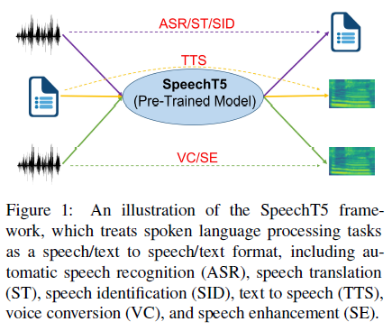

Slide 6
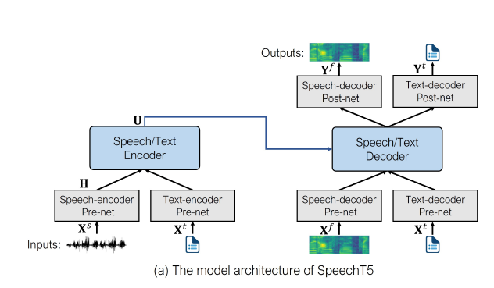

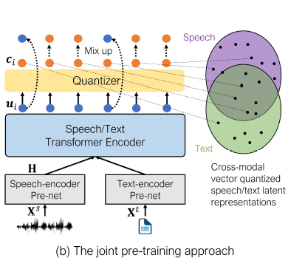
METHODS
Model Architecture
Consists of an encoder-decoder module and six modal-specific pre/post nets.
The pre-nets convert the input speech X^{s} D^{s} or text X^{t} D^{t} to a unified space of hidden representations and then feed them into the shared encoder-decoder to perform the sequence-to sequence conversion.
Finally, the post-nets generate the output in the speech or text modality, based on the decoder output.

Slide 7
1. The first module uses a linear layer fed with the decoder output to predict the log Melfilterbank, followed by five
1-dimensional convolutional layers to produce a residual to refine the predicted Yf.
2. A linear module to project the decoder output to a scalar for predicting the stop token.
Use Shared embeddings
Transforms the hidden
state into the probability distribution of tokens, normalized by the softmax function.
Encoder-Decoder Backbone -The Transformer encoder-decoder model (Vaswani et al., 2017) is used as the backbone network of SpeechT5.
Employ the relative position embedding to help capture the relative position differences between elements in the input. (only add the relative position embedding to the dot-product weights of the self-attention)
Convolutional feature extractor of wav2vec 2.0
- to downsample raw waveform X^{s} and produce a sequence of a speech utterance H = (h¹ ,…, h_{Nh}).
Neural Network-
three fully connected layers with the ReLU activation, fed with the log Mel-filterbank X^{f} .
To support multi-speaker TTS and VC, the speaker embedding extracted with the x-vector is concatenated with the output of the speech-decoder pre-net followed by a linear layer.
Use Shared embeddings
Transforms a token index into an embedding vector.
Use Shared embeddings
Transforms a token index into an embedding vector.
Input/Output Representations - The model is fed with speech/text as the input and generates the corresponding output in the speech/text format.
Split text into a sequence of characters X^{t} = (x^{t}₁,…, x^{t} _{Nt}) as the input and output.
For speech modality, the raw waveform X^{s} =(x^{s}₁,…, x^{s} _{Ns}) is used as the input, and a sequence of the log Mel-filter bank features X^{f} = (x^{f}₁ ,…, x^{f} _{Nf} ) extracted from raw audio using librosa tool is adopted as the target output.
A vocoder (Kong et al., 2020) is leveraged to generate the final waveform from the generated features.

Slide 8



Pre training
Can be pre trained with large-scale collections of unlabeled speech and text corpus.
[1] Speech pre-training-SpeechT5 is trained with two types of tasks: bidirectional masked prediction and sequence-to-sequence generation.
Bidirectional masked prediction- this uses a masked language model similar to BERT. – produce masked speech utterance H (Ĥ). In Speech-encoder pre-net.
Transformer encoder takes masked H as input & produces hidden representation U = (u₁,….,u_{Nh})
Calculate cross-entropy loss ( )
Sequence-to-sequence generation- propose to reconstruct the original speech, given the randomly masked input as introduced in bidirectional masked prediction.
Following seq2seq TTS models (Li et al., 2019), generate predicted output Y^{f} , which is generated through the speech-decoder pre-net, Transformer decoder, and speech-decoder post-net, to be close to the original X^{f} by minimizing their L1-distance ( ) [speech-reconstruction loss]
Calculate the binary cross-entropy (BCE) loss ( ) , a cross-entropy loss specific to the stop token when speech is decoded.

Slide 9



[2] Text Pre-Training – With unlabeled text data, reconstruct the model output Y^{t} to the original text X^{t}, using the corrupted text Ĥ^{t} as the input generated with a mask-based noising function.
Following the text infilling approach in BART (Lewis et al., 2020), randomly sample 30% of text spans to mask, where the span length of text spans draws from a Poisson distribution ( = 3:5), and each span is replaced with a single mask token.
Optimizing to generate the original sequence with the maximum likelihood estimation ( )
[3] Joint Pre-Training-
The proposed joint pre-training method can align the textual and acoustic information into a unified semantic space.
To build a cross-modality mapping between speech and text, which is essential for tasks such as ASR and TTS, propose a cross-modal vector quantization method to learn representations capturing the modality-invariant information.
Utilize vector quantized embeddings as a bridge to align the speech representation and text representation through a shared codebook.
Calculate diversity loss ( ) L_{d} is used to encourage sharing more codes by maximizing the entropy of the averaged Softmax distribution.
Final pre-training loss with unlabeled speech & text data can be formulated as:

Slide 10
Fine tuning
Fine-tuning the encoder-decoder backbone via the loss of the downstream task.- The goal is to measure the learning abilities of SpeechT5.
Study the performance on a diverse set of downstream tasks such as ASR, TTS, ST, VC, SE, and SID.
Example : ASR, the final model consists:
speech-encoder pre-net, encoder-decoder, text-decoder pre-net, and text-decoder post-net, which are initialized by SpeechT5 and fine-tuned via the cross-entropy loss on the corresponding training data.
The baseline systems have the same architecture as SpeechT5, but the weights of the baseline encoder are initialized by the HuBERT BASE model (Hsu et al., 2021) if the input data of the downstream tasks is speech.
It allows raw waveform as the model input and can provide a strong baseline.

Slide 11
EXPERIMENTS
Pre-Training Setup
All models are implemented in Fairseq - Facebook AI Research Sequence-to-Sequence Toolkit written in Python. https://github.com/pytorch/fairseq
A medium-size encoder-decoder model (12 encoder blocks, 6 decoder blocks, model dimension 768, inner dimension 3072, and the number of attention heads is 12) is trained using LibriSpeech for speech pre-training and LibriLM for text pre-training.
The above encoder setting is the same as that in wav2vec 2.0 BASE and HuBERT BASE.
The speech-encoder pre-net contains 7 blocks of temporal convolutions, each of which is composed of 512 channels with strides (5; 2; 2; 2; 2; 2; 2) and kernel sizes (10; 3; 3; 3; 3; 2; 2). For the speech-decoder pre-net and post-net, we use the same setting as the pre-net and post-net in Shen et al. (2018) except that the number of channels of the post-net is 256.
For textencoder/ decoder pre/post-net, a shared embedding layer with dimension 768 is used. For the vector quantization, we use two codebooks with 100 entries for the shared codebook module, resulting in a theoretical maximum of K = 104 code entries.
For speech pre-training, used the full 960 hours of LibriSpeech audio.
For text pre-training, used the normalized language model training text of LibriSpeech as unlabeled data, which contains 400M sentences. Optimize the model with Adam (Kingma and Ba, 2014) by warming up the learning rate for the first 8% of updates to a peak of 2 x 10⁻⁴, which is linear decayed for the following updates. Pre-train the proposed SpeechT5 model on 32 V100 GPUs with a batch size of around 90s samples per GPU for speech and 12k tokens per GPU for text and set the update frequency to 2 for 500k steps.

Slide 12
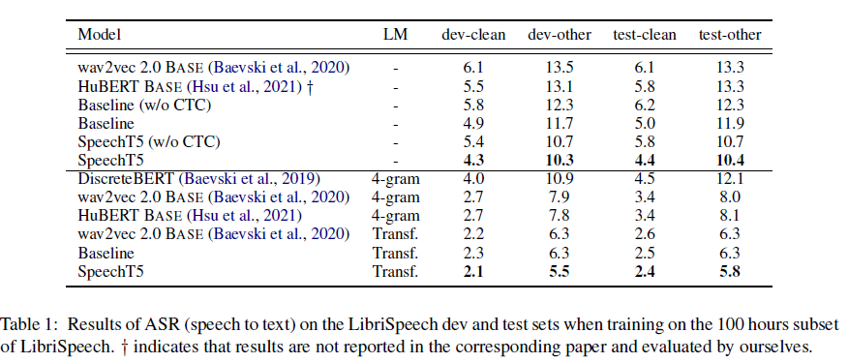
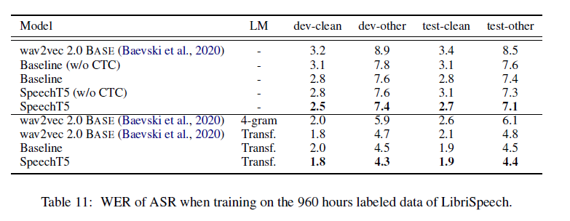
EVALUATION:
Evaluation on ASR
Fine-tune the ASR model with the LibriSpeech 100/960 hours data and train the language model(LM) with the LibriSpeech LM text data, which is used for shallow fusion. Besides the cross-entropy loss for the decoder, they have added an extra linear layer to calculate the connectionist temporal classification (CTC) loss on the top of the encoder so that they can apply the joint CTC/attention decoding, to boost the performance.
Measure the performance of ASR by the word error rate (WER).
SpeechT5 model achieves significant improvement even without LM fusion, and it performs comparable or even better than wav2vec 2.0 with LM fusion
Without LM fusion, the baseline outperforms wav2vec 2.0 BASE and HuBERT BASE.
SpeechT5 model achieves significant improvements on all settings compared to wav2vec 2.0 BASE, HuBERT BASE.
when decoding with LM fusion, SpeechT5 obtains the lower WERs than wav2vec 2.0 BASE on all sets and achieves the state-of-the-art performance

Slide 13
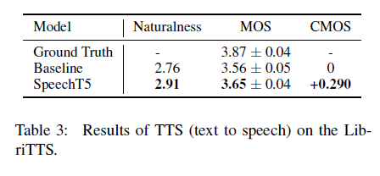
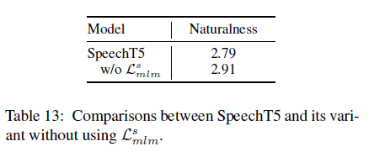
Evaluation on TTS
Fine-tune the pre-trained model on the 460-hours LibriTTS clean sets with the L₁ loss, BCE loss, and attention loss.
Evaluate the Naturalness with the open-source NISQA-TTS (Mittag and Möller, 2020), the Mean Option Score (MOS), and the Comparison Mean Option Score (CMOS) by native speakers on the randomly selected 200 sentences with various lengths (no overlapping with training data).

Slide 14
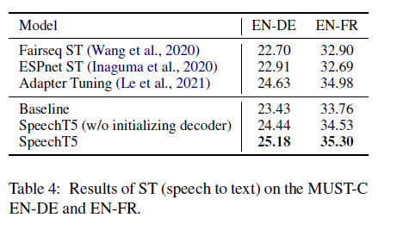
Evaluation on ST
Evaluate the ST task on the MUST-C dataset (Di Gangi et al., 2019), including English-German (EN-DE) and English-French (EN-FR) translation tasks.
Use the default training setting of speech translation in Fairseq ST (Wang et al., 2020), and average the last 10 checkpoints and use a beam size of 5 for decoding.
Translation results are evaluated with case-sensitive BLEU (bilingual evaluation understudy) (Papineni et al., 2002)

Slide 15
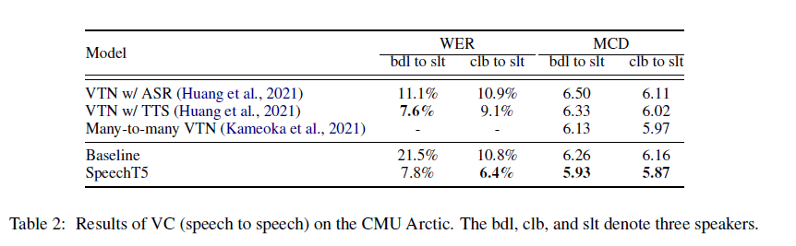
Evaluation on VC
Follow the many-to-many setting and utilize speech recordings of four speakers in the CMU Arctic (Kominek and Black, 2004), including clb, bdl, slt, and rms.
Employ the average of MCD (Mel-Cepstral Distortion) and WER as the metrics for the VC task evaluation.
Fine tuning with L₁ loss, BCE loss, and attention loss.

Slide 16
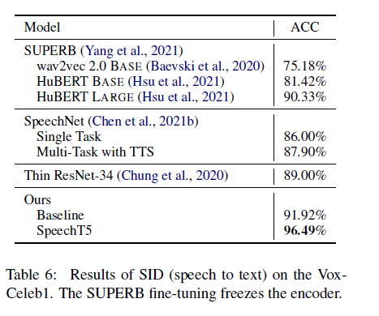
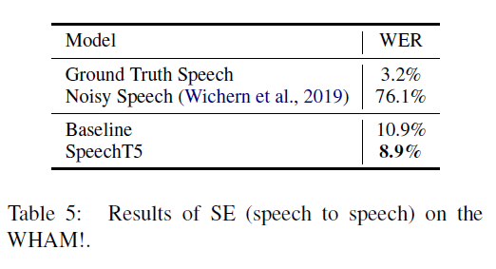
Evaluation on SID
Convert SID, a multi-class classification task of classifying each utterance for its speaker identity, to a speech to text task by sequence-to-sequence model.
Used VoxCeleb1 dataset.
Fine tuning with cross entropy.
Evaluation on SE
SE is the task of removing background noise from a degraded speech signal and improving the intelligibility and the perceived quality of the signal.
Used WHAM (WSJ0 Hipster Ambient Mixtures) dataset.
Fine tuning with L₁ loss, BCE loss, and attention loss.

Slide 17
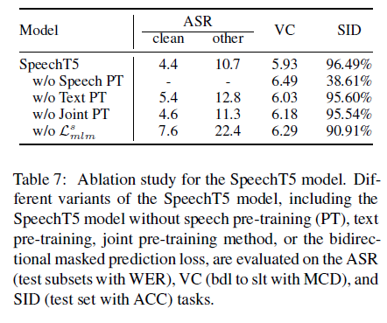
Ablation Study
To better understand why the proposed SpeechT5 model is effective, they investigate the influence of the pre-training methods by removing each of them independently.

Slide 18
ACHIEVEMENTS
To the best of the knowledge, this is the first work to investigate a unified encoder-decoder framework for various spoken language processing tasks.
Proposing the cross-modal vector quantization approach, which learns the implicit alignment between acoustic and textual representation with large-scale unlabeled speech and text data.
Extensive experiments on spoken language processing tasks demonstrate the effectiveness and superiority of the proposed SpeechT5 model.

Slide 19
CONCLUSION
SpeechT5 as a pre-trained encoder-decoder model for various spoken language processing tasks.
The proposed unified encoder-decoder model can support generation tasks such as speech translation and voice conversion.
Massive experiments show that SpeechT5 significantly outperforms all baselines in several spoken language processing tasks.
FURTHER WORKS
Going to pre-train the SpeechT5 with a larger model and more unlabeled data.
Extending the proposed SpeechT5 framework to address multilingual spoken language processing tasks.
Notes:
mSlam : https://arxiv.org/pdf/2202.01374.pdf

Slide 20
Limitations of the study
Unclear points on the computation of loss:
(a) speech reconstruction L1 loss (the reason for adding this loss component is unclear and no ablation study supports its usefulness)
(b) diversity loss - cross-modal objective to better align speech and text representations (it is unclear, from the paper whether or not this specific loss needs aligned speech-text data to be computed.
Fine-tuning process
multi-modal fine tuning -> mSLAM
mSLAM benefits from multi-modal fine-tuning, further improving the quality of speech translation by directly leveraging text translation data during the fine-tuning process.

